Slide 1

Project Webapp Bartender Website
By Phạm Đinh Hoàng Việt
Lê Thanh Phương Nam
Đặng Đình Khang
Phạm Công Tuấn

Slide 2

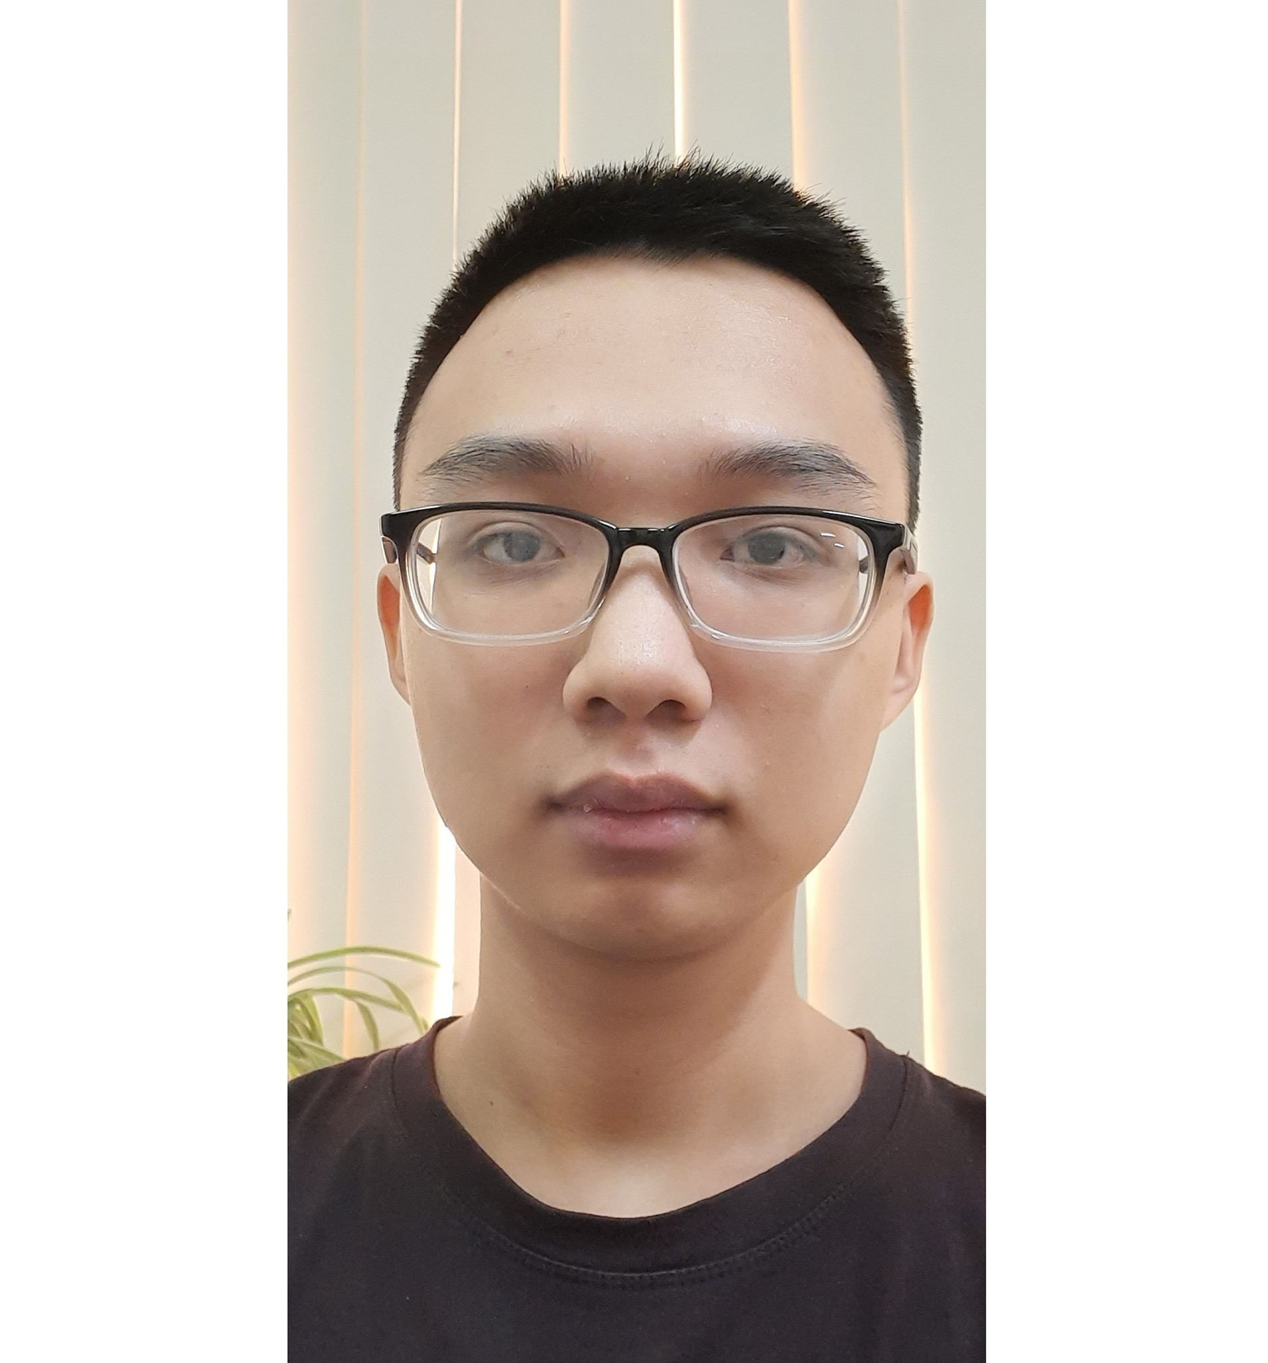


Team
Hoàng Việt
Công Tuấn
Phương Nam
Đình Khang
Leader
Front end
Back end
Design

Slide 3



Content
Introduction
Specifications
Development
Demo
Duration: 20’

Slide 4

Introduction to the site
Speaker: Hoàng Việt

Slide 5
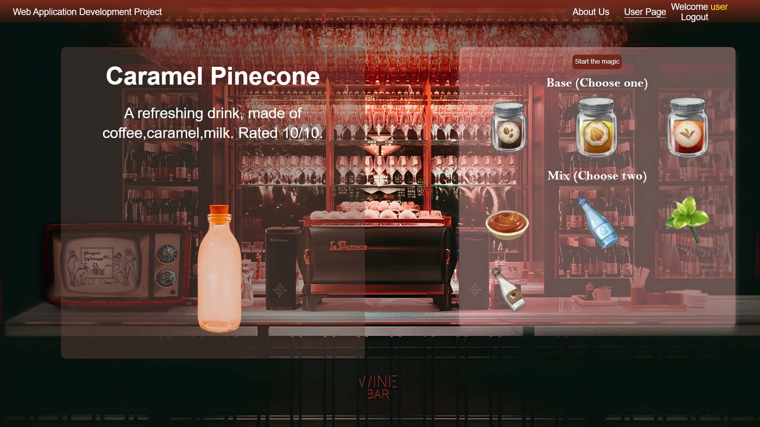
Bartender website lets visitor choose the ingredients and provide the drinks

Slide 6

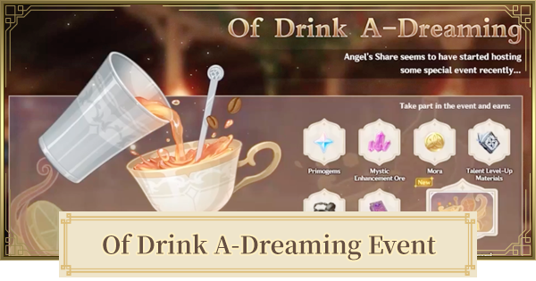
Inspired by Genshin Impact

Slide 7
Specifications
Speaker: Công Tuấn, Phương Nam

Slide 8
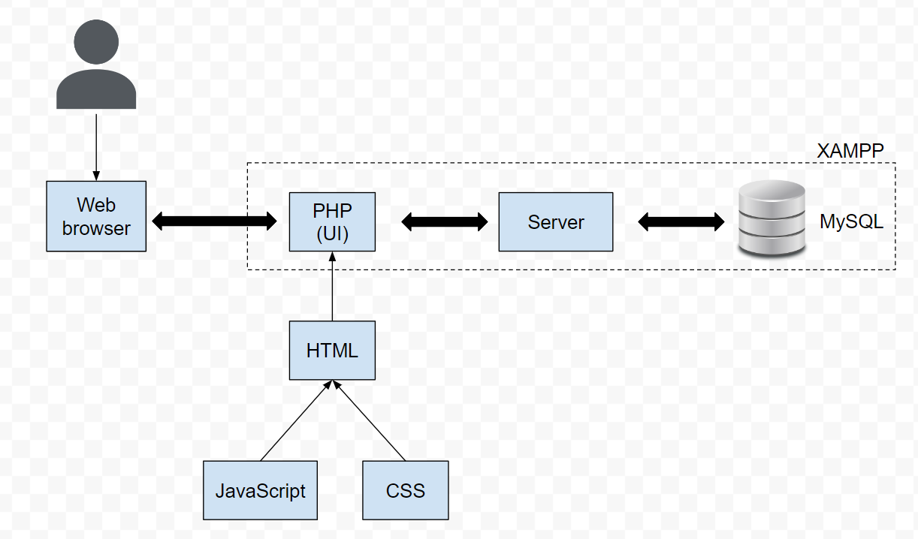
System Design
Version control
Git

Slide 9
Front end
HTML: elements, DOM
CSS: styling for html files
JS: functions, interaction capability
PHP: wrapper, add backend codes

Slide 10
Back end
XAMPP: Easy-to-install Apache distribution containing PHP
MySQL: An open-source relational database management system (RDBMS)

Slide 11
Main use cases
User creates account, log in, log out
Admin deletes account
User searches drinks (input ingredients, output drink name)

Slide 12
Number | Use Case Name | Use Case Description
1 | User register | A visitor to the website clicks on “register”, fills in the form, and submits
2 | User login | A visitor clicks on “log in”, fills in the form, and submit
3 | User change password | A registered user clicks on “forget password” to change
4 | Delete user | Admin bans inappropriate users (bad names, system exploiting, …)
5 | Search recipe | A user searches for the drink by choosing 3 ingredients
User logout by clicking a button. That’s all

Slide 13
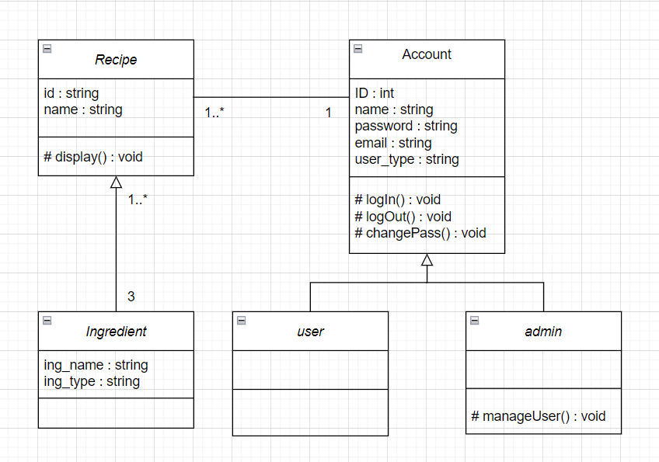
Class Diagram

Slide 14
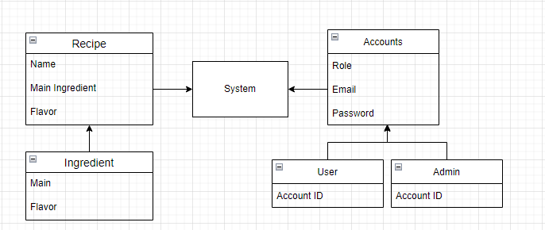
Data Requirements
Data Requirements

Slide 15
Development
Speaker: Đình Khang

Slide 16

The way to get started is to quit talking and begin doing.
Walt Disney

Slide 17
Responsibility
 | Việt | Tuấn | Nam | Khang
Week 1 | Brainstorm idea | Prepare front end Design resources | Prepare back end | Prepare system design
Week 2 | Suggest idea Report | Code front end | Improve idea Write report | Improve idea
Week 3 | Write report | Fix front end | Code back end | Write report
Week 4 | Testing | Write report Testing | Write report Testing | Testing

Slide 18
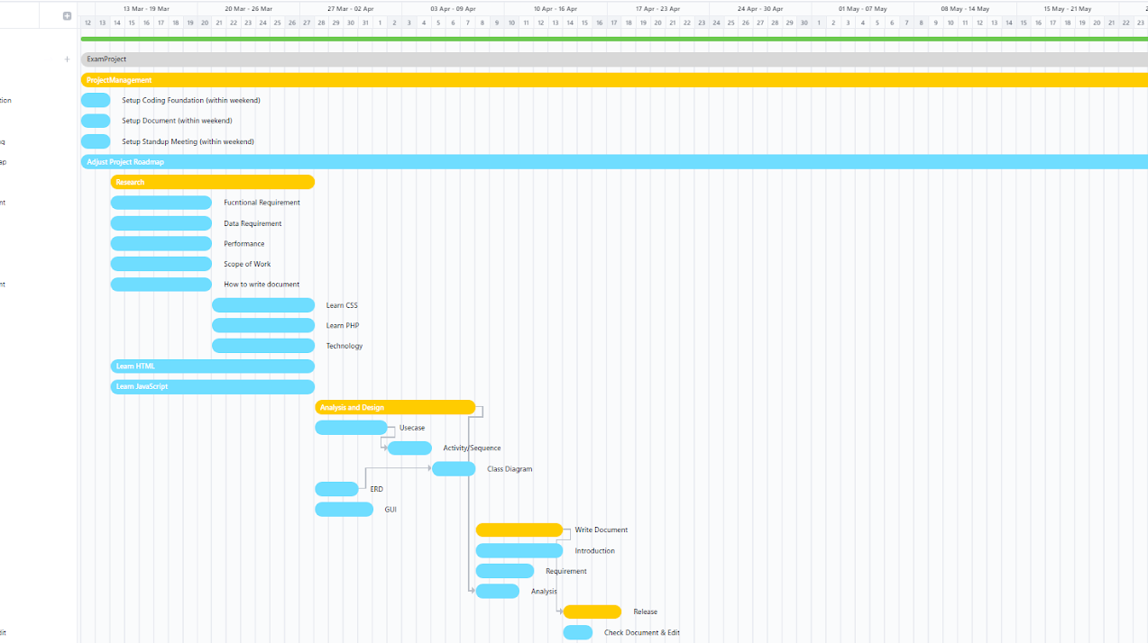
Set up
Check requirements
Check techs
Design system
Documents
Release

Slide 19
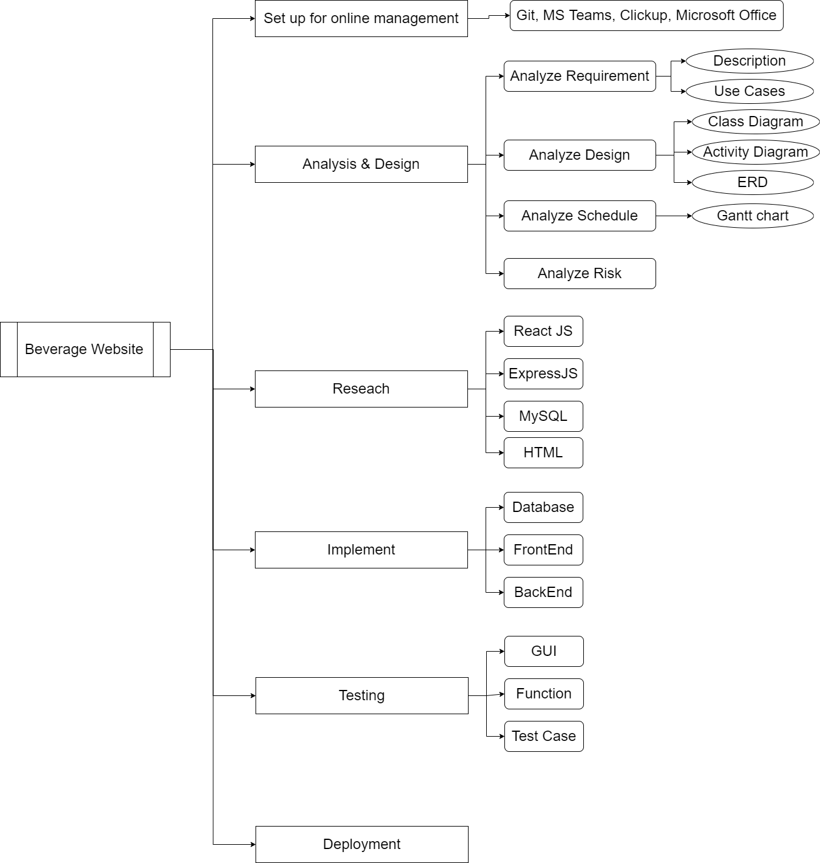
Workbench (1/2)

Slide 20
Workbench (2/2)

Slide 21
Difficulties & Solutions
Overestimate team ability
Lack of time
Back end is a pain
Scale down the project
Set deadlines
Indian youtube tutorials

Slide 22

Summary
Bartender site combines front end with back end and database to function. With some improvements, it would become a great entertainment.

Slide 23


Thank You

Slide 24
Demo
Speaker: Phương Nam

